Slide 1
Case Study 1 Group3: Morphine
Emily Gentles, Weiyi Liu,
Jack McCarthy, Qinzhe Wang

Slide 2
Introduction
Our drug of interest is Morphine
Used to relieve moderate to severe pain
May be habit-forming, especially with prolonged use (MedlinePlus)
Aim of this study is to explore the relationship between the sale price per milligram of the diverted pharmaceutical substance Morphine and other reported factors
Location, reason for purchasing, time of purchase, etc
Data source: StreetRx

Slide 3
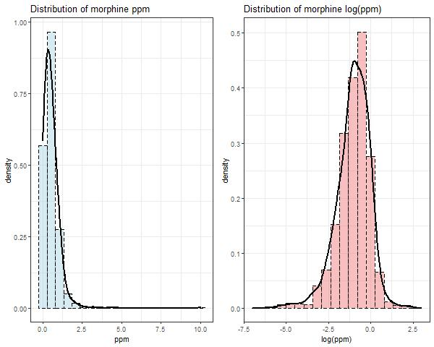
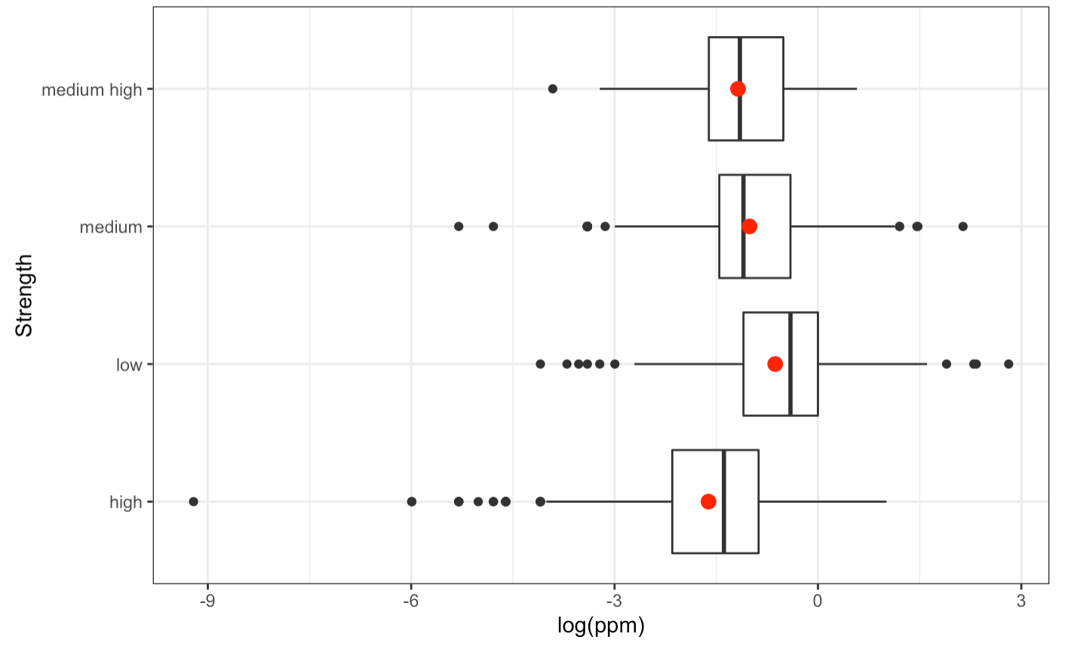
EDA - ppm & mgstr
ppm
mgstr
Distribution of ppm and log(ppm)
Boxplot of log(ppm) vs. strength
Recode the mgstr based on quantiles

Slide 4
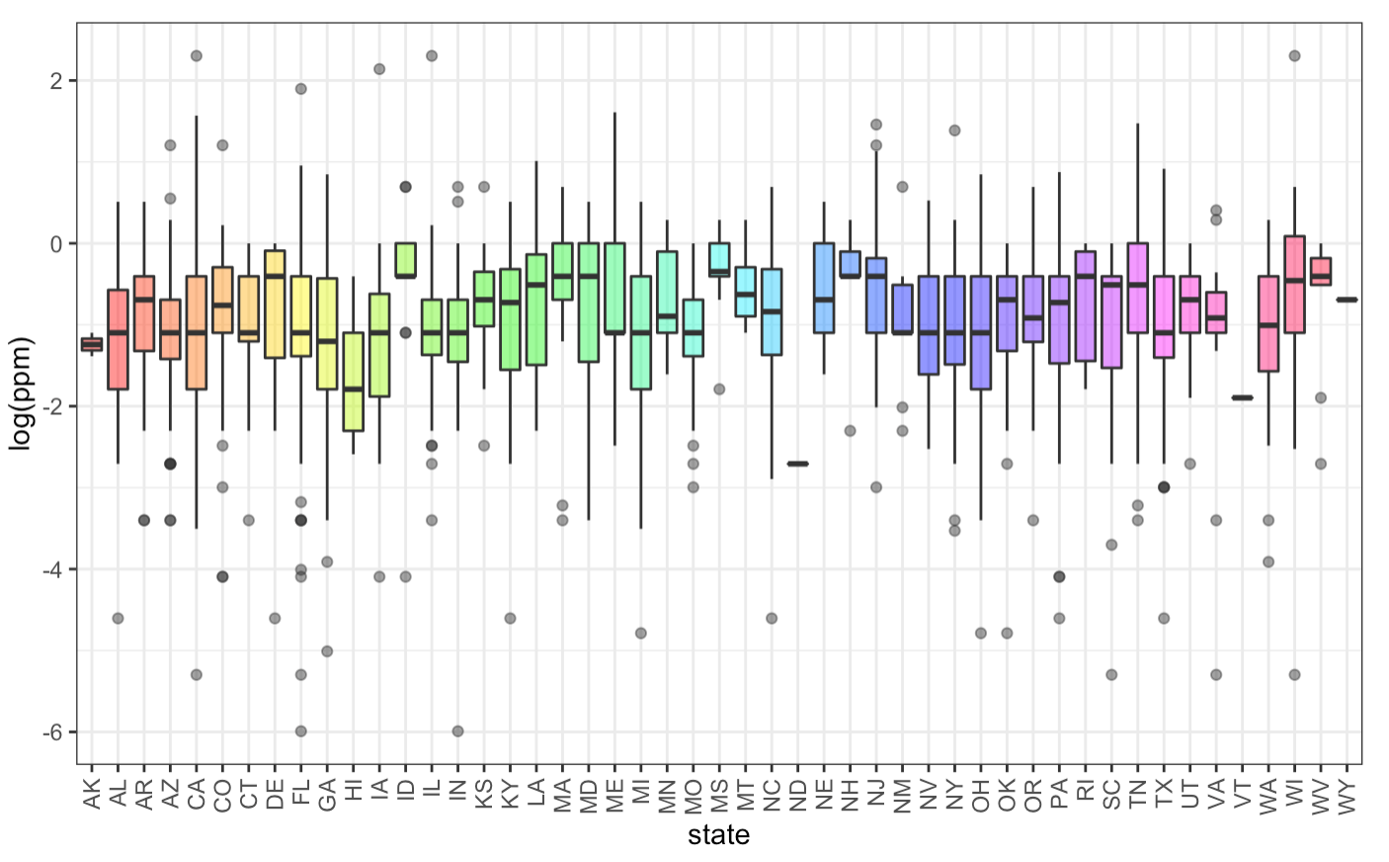
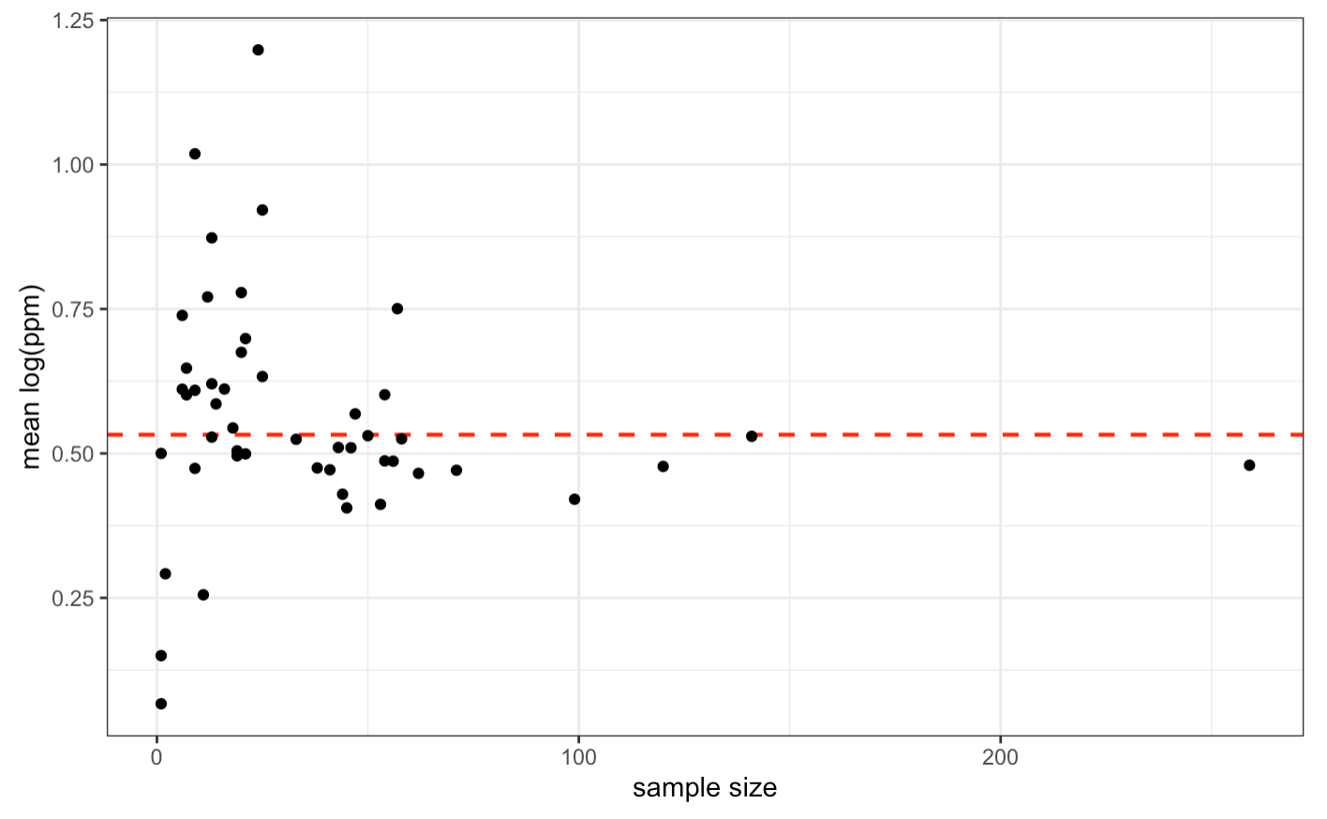
EDA - state
States with Smallest Sample Sizes
North Dakota | Vermont | DC | Wyoming | Alaska
1 | 1 | 1 | 1 | 2
Boxplot of log(ppm) vs. state
group mean vs. sample size

Slide 5
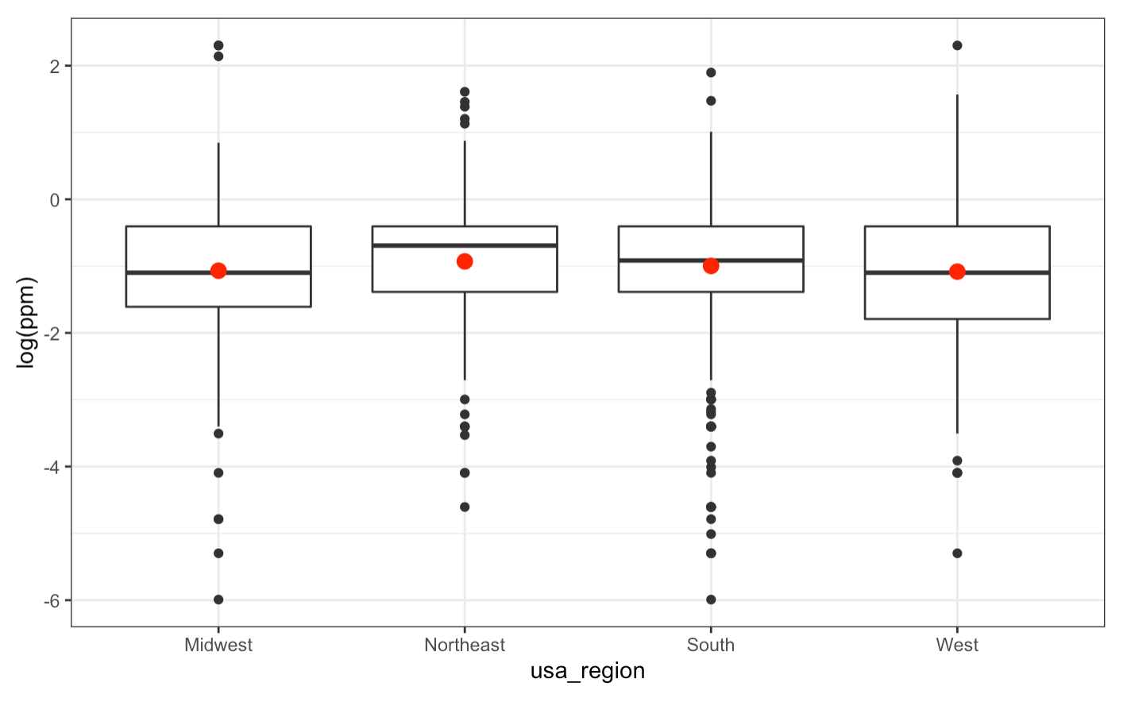
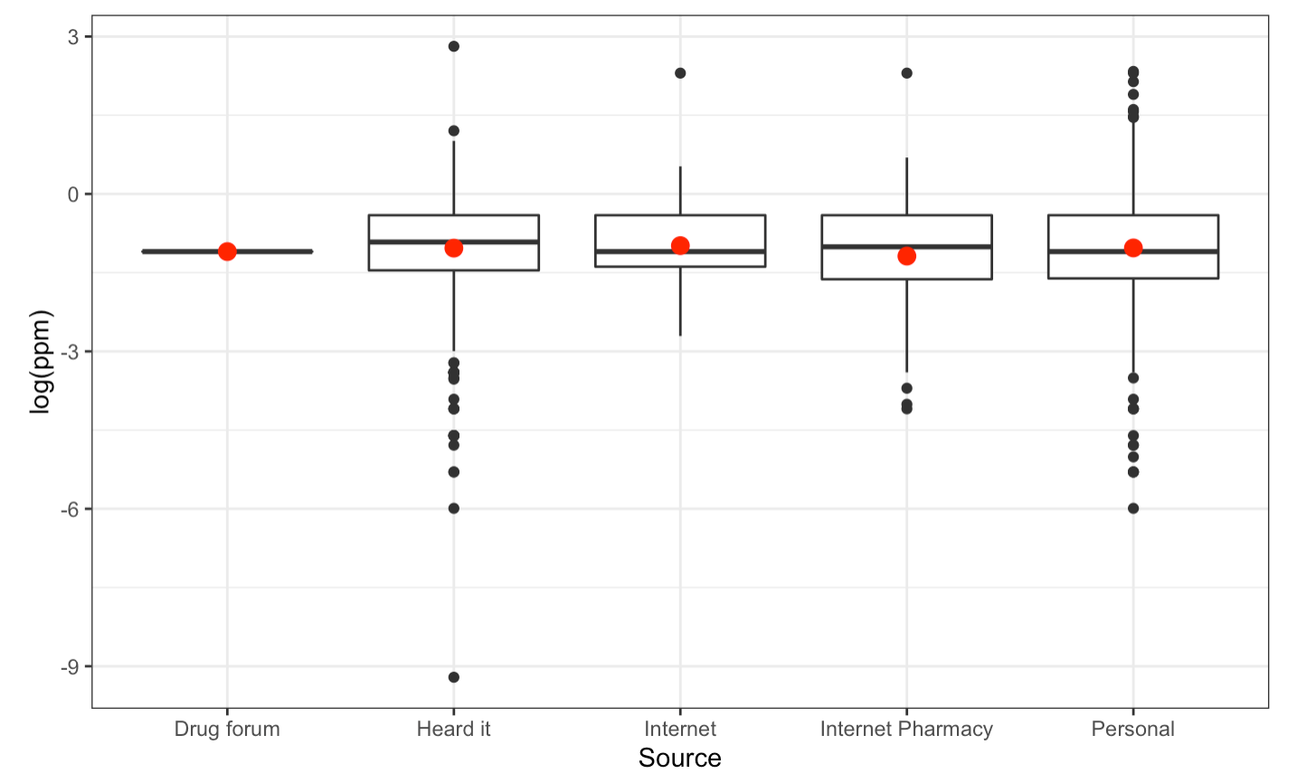
EDA - region & source
Boxplot of log(ppm) vs. region
Boxplot of log(ppm) vs. source

Slide 6
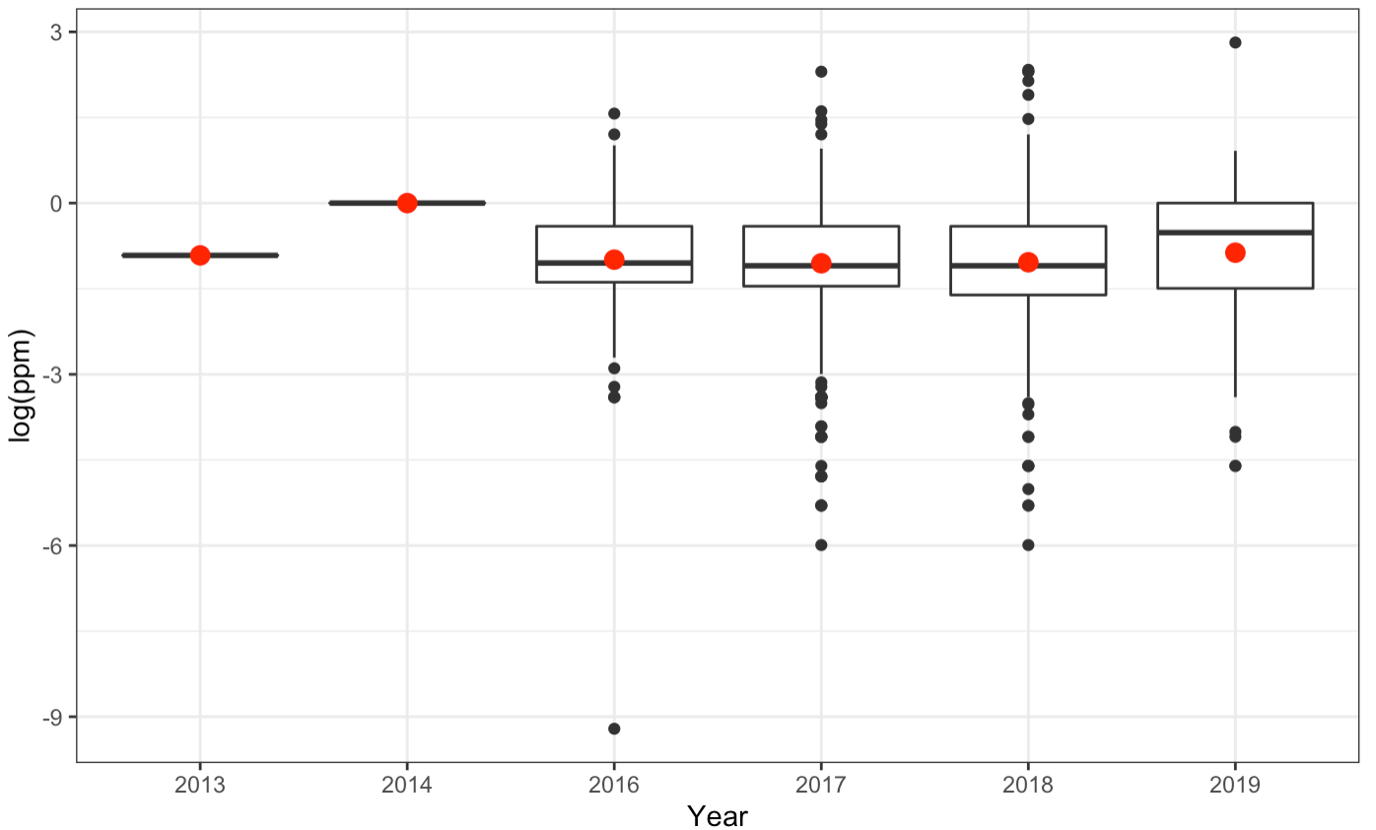
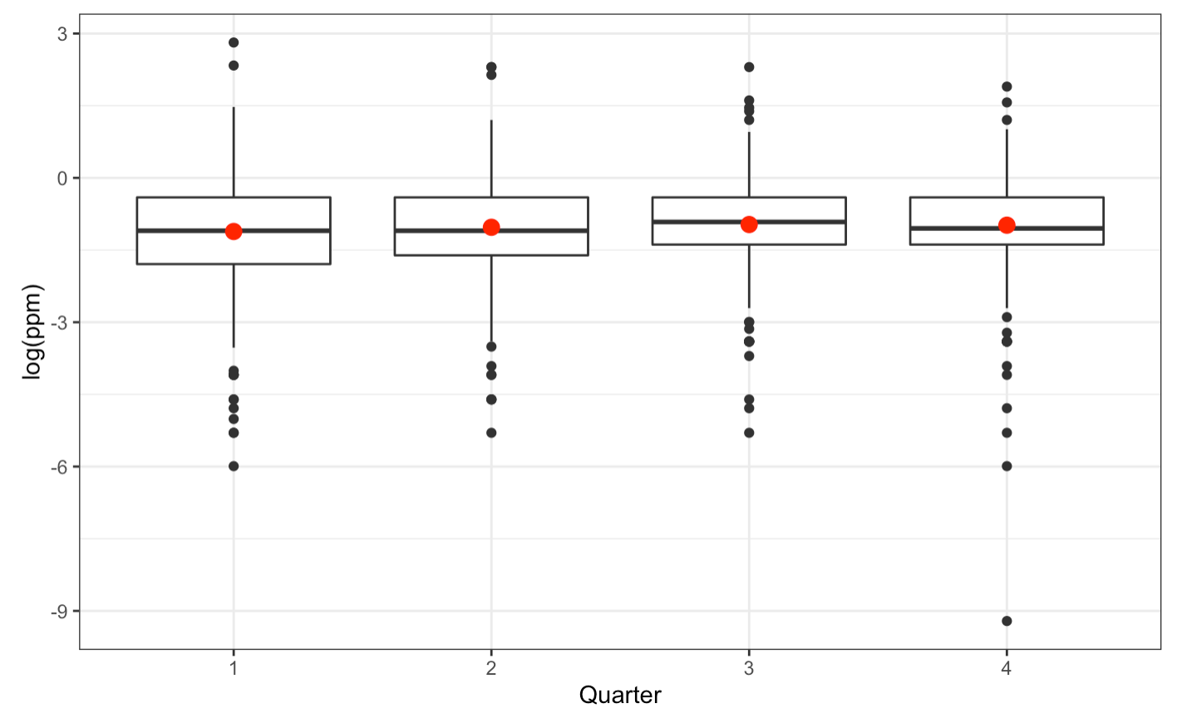
EDA - year & quarter
Boxplot of log(ppm) vs. year
Boxplot of log(ppm) vs. quarter

Slide 7
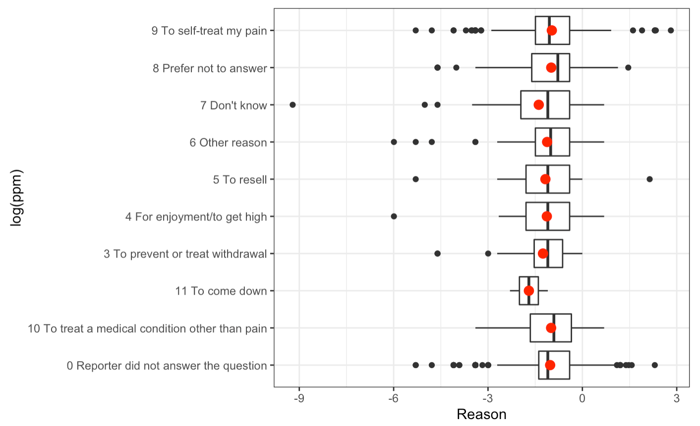
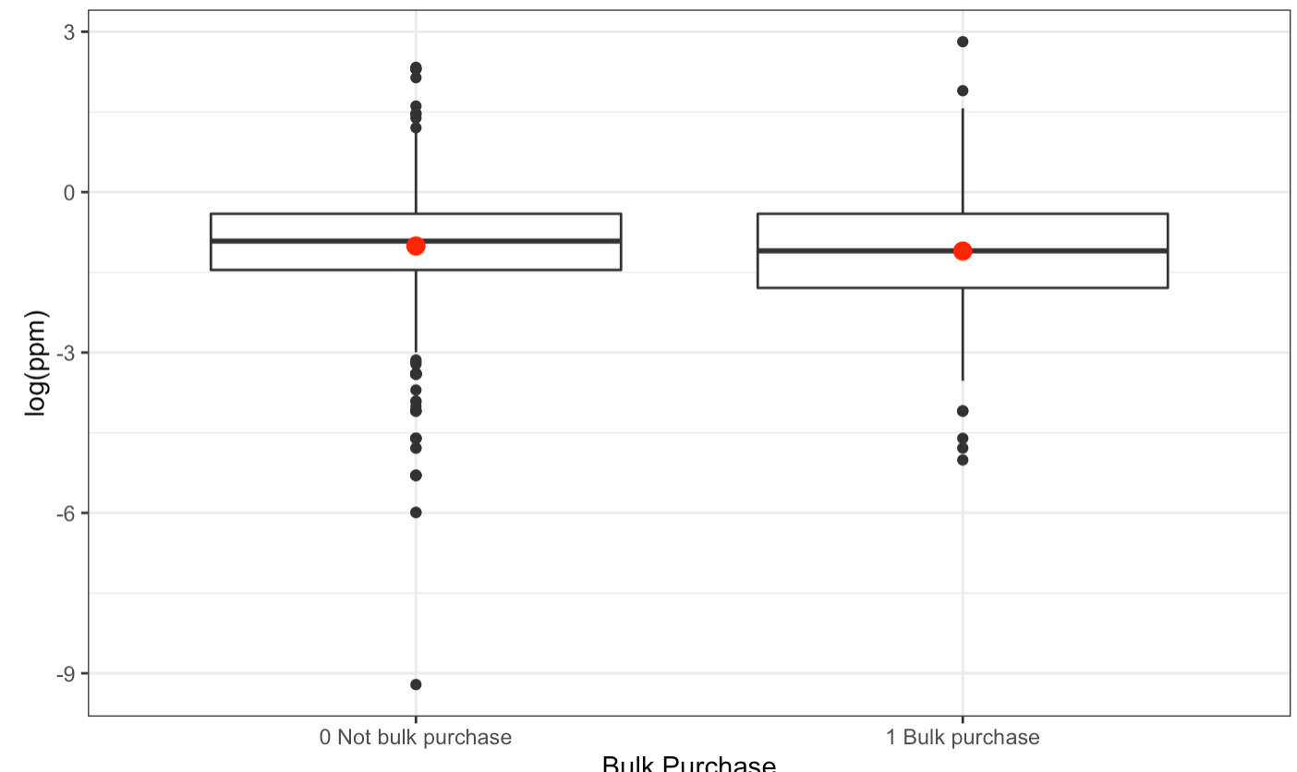
EDA - year & quarter
Boxplot of log(ppm) vs. primary reason
Boxplot of log(ppm) vs. bulk purchase

Slide 8
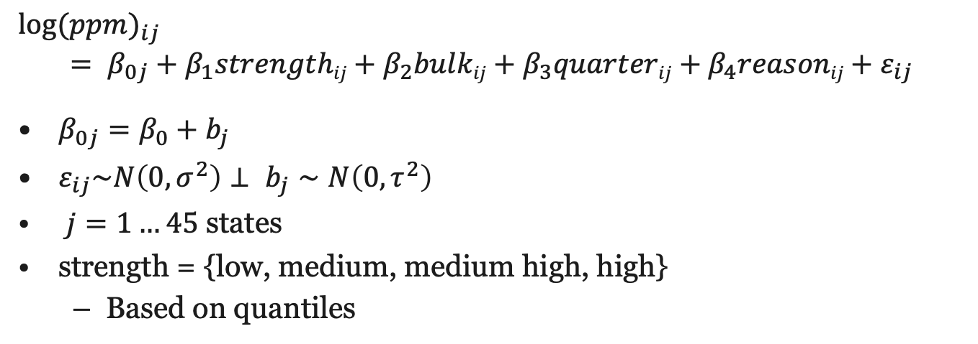
Model
$$\log{{(ppm)}_{ij}}$$
$$= β_{0j}+β_{1}strengthij+β_{2}bulkij+β_{3}quarterij+β_{4}reasonij+ε_{ij}$$
$β_{0j}=β_{0}+b_{j}$
$ε_{ij}\sim N\left(0,σ^{2}\right)⊥ b_{j}∼N\left(0,τ^{2}\right)$
$j=1…45$ states
strength = {low, medium, medium high, high}
Based on quantiles

Slide 9
Model Selection
Grouping | BIC
State | 5064.901
City | 5073.967
Region | 5072.387
ANOVA
Variable | P-Value
Source | 0.762
City | 0.515
Reason | 0.086
Quarter | 0.063
Strength | <2e-16
Bulk | 0.042

Slide 10
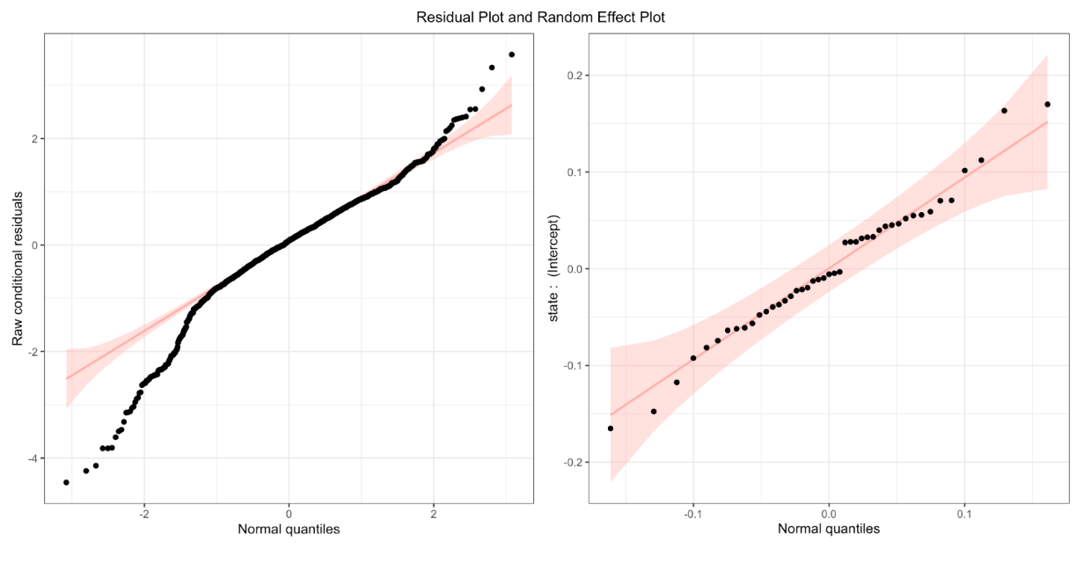
Model Diagnostics
Normality
Slightly met
Heavy tails on both the left and right
Removed extreme outliers
Random effects seem to be relatively normal

Slide 11
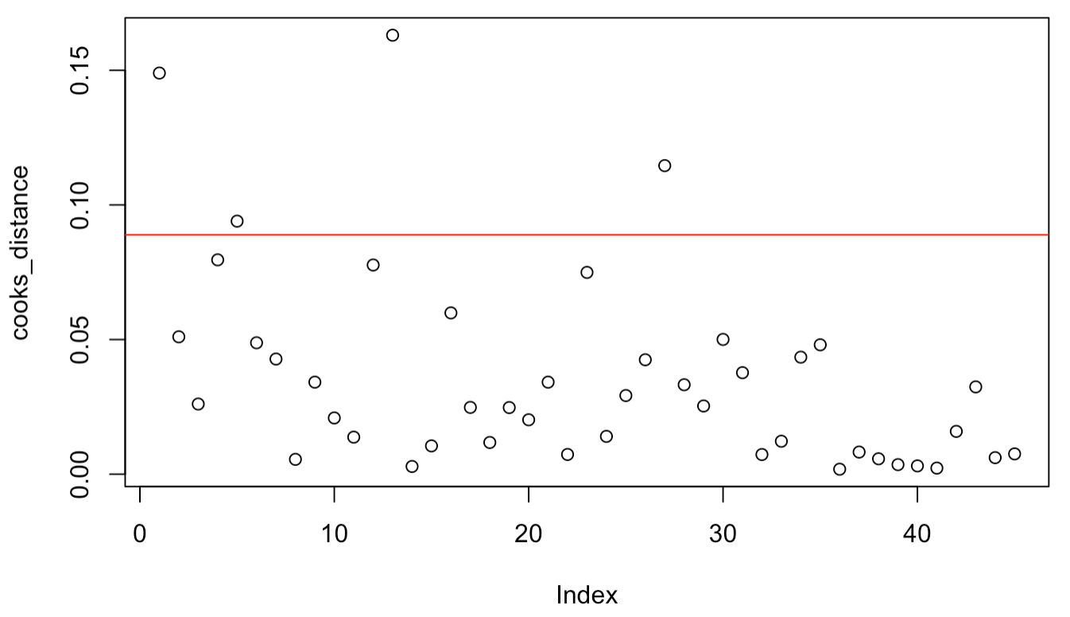
Model Diagnostics
Independence
Unlikely to be fully met as a user of the website is likely to report multiple times within the same state
Outliers
Multiple states with high sample sizes such as AZ are highly influential
Even when removing these states, the condition (normality) does not improve
Cooks Distance

Slide 12
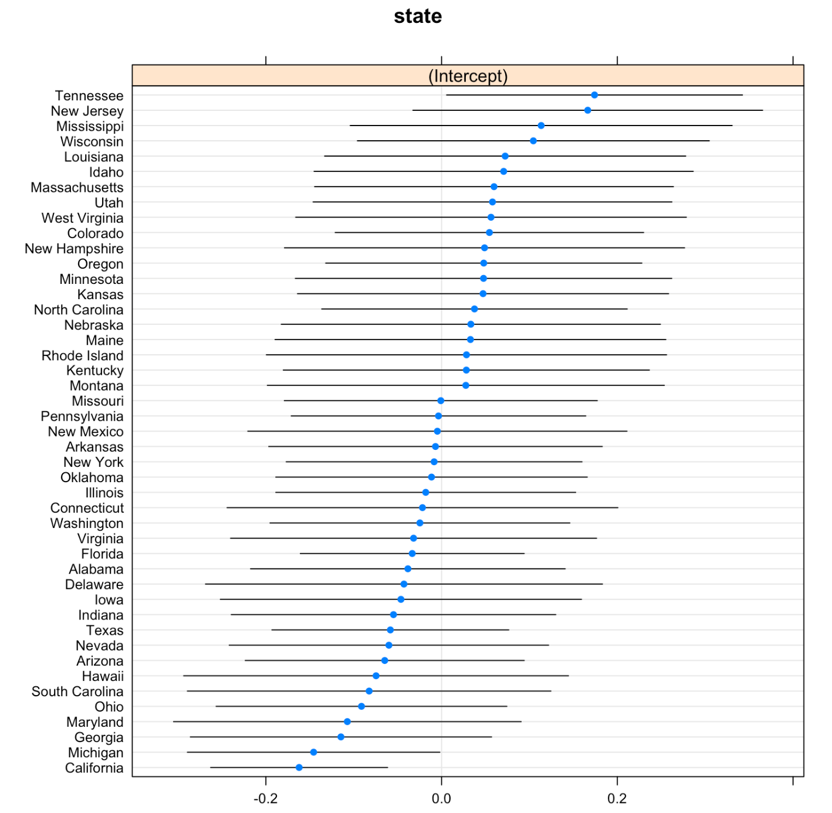
Results and Future Work
Results
Tennessee has the largest estimated intercept
n = 57
California has the lowest estimated intercept
n = 259
Future work
Interactions
Attempt to address violated assumptions

Slide 13
Q&A
Thanks for listening!

